Slide 1
CYBERSPACE AND CRIMINAL BEHAVIOR

Slide 2
Cyberspace
Cyberspace refers to the virtual space that provides the infrastructure, electronic medium and related elements necessary for online global communication.
It can be thought of as the second life space where human beings operate for social interactions, entertainment, business operations as well as for personal activities and interests.
The term cyberspace is derived from the word cybernetics which in turn is extracted from ancient Greek word kubernētēs, that refers to steersman or to give direction.
The term cyberspace first came into existence in various contexts in visual arts and science fiction during 1940, 1960 and 1984.
However, the first reference was made by the founder of Electronic Frontier Foundation, in the year 1990 and later in 1991 by Mr. Benedict, which is close to the existing relationship of computer and telecommunication systems.
The virtual library of information offers required information on any topic at any point of time and cyberspace acts as the informational resource now-a-days. Entertainment and social networking play a major role in cyberspace as the cyberspace has been evolving as a great medium to connect people these days.

Slide 3
The advantages of cyberspace include
Informational resources
Entertainment
Social networking

Slide 4
Disadvantage
The disadvantages are due to this great medium of connectivity, as it leads to spamming, theft of information and threats etc.
A cybercriminal is an individual who commits cybercrimes, where he/she makes use of the computer either as a tool or as a target or as both.
Cybercriminals tries to use the computers in three broad ways. Firstly, they use the computer as their target for attacking other people's computers for the purpose of fulfilling their malicious activities like spreading viruses, data theft, identity theft, etc.
Secondly, they use the computer as their weapon for the purpose of carrying out conventional crime like spam, fraud, illegal gambling, etc.
Thirdly, they use the computer as their accessory for the purpose of saving stolen or illegal data.Thus cyberspace provides a platform for all criminal activities and therefore, security is a major challenge.

Slide 5
TRADITIONAL PROBLEMS ASSOCIATED WITH COMPUTER CRIME
Physicality and Jurisdictional Concerns
Perceived Insignificance, Stereotypes, and Incompetence
Prosecutorial Reluctance
Lack of Reporting
Lack of Resources
Jurisprudential Inconsistency

Slide 6
Physicality and Jurisdictional Concerns
Individuals sitting at their desk can enter various countries without the use of passports or documentation.
For successful prosecution it is necessary to get the specification of the crime scene i.e.,
1. Where did the crime actually occur?
2. Which laws apply?
3. Which agency is responsible for the investigation of a particular incident?
4. Which agency has primary jurisdiction over the thief?

Slide 7
Digital Forensics
The process of identifying preserving, analyzing and presenting digital evidence for a legal proceeding

Slide 8
DIGITAL FORENSICS
Digital Forensics is the preservation, identification, extraction, interpretation and documentation of computer evidence which can be used in the court of law. Technically, the term computer forensics refers to the investigation of computers. Digital forensics includes not only computers but also any digital device, such as digital networks, cellphones, flash drives and digital cameras.

Slide 9
Process of Digital forensics
Digital forensics entails the following steps:
Identification
Preservation
Analysis
Documentation
Presentation

Slide 10
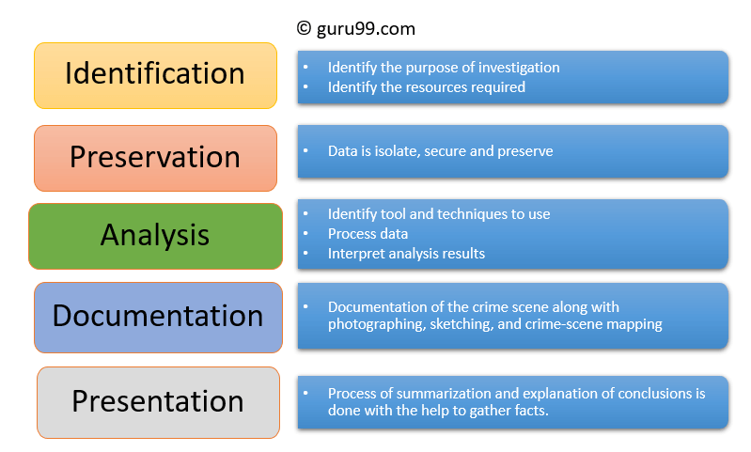
Process

Slide 11
Types of Digital Forensics
Disk Forensics
Network Forensics
Wireless Forensics
Database Forensics
Malware Forensics
Malware Forensics
Memory Forensics
Mobile Phone Forensics

Slide 12
Challenges faced by Digital Forensics
The increase of PC’s and extensive use of internet access
Easy availability of hacking tools
Lack of physical evidence makes prosecution difficult.
The large amount of storage space into Terabytes that makes this investigation job difficult.
Any technological changes require an upgrade or changes to solutions.

Slide 13
Example Uses of Digital Forensics
Intellectual Property theft
Industrial espionage
Employment disputes
Fraud investigations
Inappropriate use of the Internet and email in the workplace
Forgeries related matters
Bankruptcy investigations
Issues concern with the regulatory compliance

Slide 14
Advantages of Digital forensics
To ensure the integrity of the computer system.
To produce evidence in the court, which can lead to the punishment of the culprit.
It helps the companies to capture important information if their computer systems or networks are compromised.
Efficiently tracks down cybercriminals from anywhere in the world.
Helps to protect the organization’s money and valuable time.
Allows to extract, process, and interpret the factual evidence, so it proves the cybercriminal action’s in the court.

Slide 15
Disadvantages of Digital Forensics
Digital evidence accepted into court. However, it is must be proved that there is no tampering
Producing electronic records and storing them is an extremely costly affair
Legal practitioners must have extensive computer knowledge
Need to produce authentic and convincing evidence
If the tool used for digital forensic is not according to specified standards, then in the court of law, the evidence can be disapproved by justice.
Lack of technical knowledge by the investigating officer might not offer the desired result

Slide 16
difference
IMT: Incident Management Team
IS Mgr leads, includes steering committee, IRT members
Develop strategies & design plan for Incident Response,
integrating business, IT, BCP, and risk management
Obtain funding, Review postmortems
Meet performance & reporting requirements
IRT: Incident Response Team
Handles the specific incident. Has specific knowledge relating to:
Security, network protocols, operating systems, physical
security issues, malicious code, etc.
Permanent (Full Time) Members: IT security specialists,
incident handlers, investigator
Virtual (Part Time) Members: Business (middle mgmt), legal,
public relations, human resources, physical security, risk, IT
Notes:
The slide shows higher ranking positions on top, lower ranking on the bottom.

Slide 17
Stages in Incident Response
Preparation
Plan PRIOR to Incident
Identification
Determine what is/has happened
Containment
& Escalation
Limit incident
[If data breach]
Analysis &
Eradication
Determine and remove
root cause
Notification
Notify any data
breach victims
Recovery
Return operations
to normal
Ex-Post
Response
Establish call center,
reparation activities
Lessons
Learned
Process improvement:
Plan for the future
Notes:
The next slides will go through these steps in detail.
Source: CISM® Review Manual 2009, © 2008, ISACA. All rights reserved. Used by permission.

Slide 18
Why is incident response important?
Average Cost of Data Breach:
Global $3.86M; U.S. $7.91M for 31,465 records
Mega Breach: 1 M records: $40 million 50 M records: $350 million
Mean Time to Identify (MTTI): Days to find, confirm breach
Mean Time to Contain (MTTC): Days to resolve breach and restore service
 | Global | U.S. | India | Criminal attack | System Glitch | Human Error
Mean Time to Identify | 196.7 | 201 | 188 | 221 | 177 | 174
Mean Time to Contain | 69.0 | 52 | 78 | 81 | 60 | 57
2018 Cost of a Data Breach Study: Global Report (IBM/Ponemon)

Slide 19
Stage 1: Preparation
What shall we do if different types of incidents occur? (BIA helps)
When is the incident management team called?
How can governmental agencies or law enforcement help?
When do we involve law enforcement?
What equipment do we need to handle an incident?
What shall we do to prevent or discourage incidents from occurring? (e.g. banners, policies)
Where on-site & off-site shall we keep the IRP?
Notes:
A business impact assessment (BIA) should be conducted by each business process (department, whatever) to determine how an incident will affect it and what steps should be taken to mitigate or respond to it. This is part of risk management as well as incident response.
The incident response plan (IRP) is the document that contains procedures to follow in case of an emergency (see slide 11). It should be usable by someone who wasn’t involved in its creation, and needs to be accessible in unusual circumstances – if the only copy is in your desk drawer when a fire guts your office building, then you’re doing it wrong.
Bullet 3, 4: meet with government emergency management (law enforcement, etc) to learn what they are capable of and how they prefer to operate.

Slide 20
(1) Detection Technologies
Organization must have sufficient detection & monitoring capabilities to detect incidents in a timely manner
Proactive Detection includes:
Network Intrusion Detection/Prevention System (NIDS/NIPS)
Host Intrusion Detection/Prevention System (HIDS/HIPS)
Antivirus, Endpoint Security Suite
Security Information and Event Management (Logs)
Vulnerability/audit testing
System Baselines, Sniffer
Centralized Incident Management System
Input: Server, system logs
Coordinates & co-relates logs from many systems
Tracks status of incidents to closure
Reactive Detection: Reports of unusual or suspicious activity
Notes:
You can’t determine if an incident has occurred unless there are detection techniques. It makes sense that there is a detection technique and/or metric for each risk of concern. The above tools do not need to be implemented, depending on the decision of risk assessment. However, they are useful tools for detecting incidents.

Slide 21
Logs to Collect & Monitor
Security
Config
Changes to sec. config.
Changes to network device config.
Authent.
Failures
Unauthor-ized accesses
New Users
Network
Irregularity
Unusual packets
Transfer of sensitive data
Log Issues
Normal
Events
Logins, logoffs
Lockouts & expired passwd accts
Change in traffic patterns
Deleted logs
Overflowing log files
Access to sensitive data
Blocked packets
Software App
Attacks: SQL injection, invalid input, DDOS
Others, listed in prev. columns
Change in privileges
Clear/ change log config
Change to files: system code/data
All actions by admin

Slide 22
Incidents may include…
Employees Reports
Malware
Violations of policy
Data breach:
stolen laptop, memory
employee mistake
Social engineering/fraud:
caller, e-mail, visitors
Unusual event:
inappropriate login
unusual system aborts
server slow
deleted files
defaced website
IT Detects
a device (firewall, router or server) issues serious alarm(s)
change in configuration
an IDS/IPS recognizes an irregular pattern:
unusually high traffic,
inappropriate file transfer
changes in protocol use
unexplained system crashes or
unexplained connection terminations

Slide 23
(1) Management Participation
Management makes final decision
As always, senior management has to be convinced that this is worth the money.
Actual Costs: Cost of a Data Breach Study, 2018, Ponemon, IBM
Expenses Following a Breach | Average Cost (U.S.)
Detection and Escalation: forensic investigation, audit, crisis mgmt., board of directors involvement | $1,210,000
Notification: legal expertise, contact database development, customer communications | $740,000
Post Breach Response: help desk and incoming communications, identity protection services, legal and regulatory expenses, special investigations | $1,760,000
Lost Business: abnormal customer churn, customer procurement, goodwill | $4,200,000
Notes:
Redundancy costs are costs of alternate equipment/lines to deal with incidents. The cost of the redundancy and detection can be weighed against the Business Impact Analysis costs when incidents occur – and the impact of how loss of computing facilities might translate into lost income.

Slide 24
Workbook Incident Types
Incident | Description | Methods of Detection | Procedural Response
Intruder accesses internal network | Firewall, database, IDS, or server log indicates a probable intrusion. | Daily log evaluations, high priority email alerts | IT/Security addresses incident within 1 hour: Follow: Network Incident Procedure Section.
Break-in or theft | Computers, laptops or memory is stolen or lost. | Security alarm set for off-hours; or employee reports missing device. | Email/call Management & IT immediately. Management calls police, if theft. Security initiates tracing of laptops via location software, writes Incident Report, evaluates if breach occurred.
Social Engineering | Suspicious social engineering attempt was recognized OR information was divulged that was recognized after the fact as being inappropriate. | Training of staff leads to report from staff | Report to Management & Security. Warn employees of attempt as added training. Security evaluates if breach occurred, writes incident report.
Trojan Wireless LAN | A new WLAN masquerades as us. | Key confidential areas are inspected daily for WLAN availability | Security or network administrator is notified immediately. Incident is acted upon within 2 hours.
Notes:
This is in an abbreviated form to fit on a slide. The Method of Detection is how we will know if an incident occurs. There may be many methods. The procedural response can refer to another document, which has a more extensive description. (Short form shown here)

Slide 25
Stage 2: Identification
Triage: Categorize, prioritize and assign events and incidents
What type of incident just occurred?
What is the severity of the incident?
Severity may increase if recovery is delayed
Who should be called?
Establish chain of custody for evidence
Notes:
You may remember from MASH (TV show and movie) that Triage is about stopping bleeding and prioritizing injuries to maximize the probability of survival. Same thing here: determining what is wrong and taking the correct first actions until the bleeding stops and the experts are ready to take over.
How to declare a disaster involves more than communication; it also means when to declare a disaster, as opposed to some lesser incident. You want your response to be proportional to the scale of the incident . If you overreact (shutting down the entire network over one unauthorized entry) you’ll waste a lot of time and money. If you underreact, the incident may become a lot worse than it already is.

Slide 26
(2) Triage
Snapshot of the known status of all reported incident activity
Sort, Categorize, Correlate, Prioritize & Assign
Categorize: DoS, Malicious code, Unauthorized access, Inappropriate usage, Multiple components
Prioritize: Limited resources requires prioritizing response to minimize impact
Assign: Who is free/on duty, competent in this area?
Notes:
Triage happens at a hospital: When you come in you are asked questions to determine how long you can wait to see a doctor. (You get prioritized compared to the other emergency patients.) They may bandage you to stop any bleeding, but think military war zone: a full operation is not done.

Slide 27
(2) Chain of Custody
Evidence must follow Chain of Custody law to be admissible/acceptable in court
Include: specially trained staff, 3rd party specialist, law enforcement, security response team
System administrator can:
Retrieve info to confirm an incident
Identify scope and size of affected environment (system/network)
Determine degree of loss/alteration/damage
Identify possible path of attack
Notes:
Chain of Custody will be necessary if anything will go to court. Need to be concerned with this right from the start, if a concern.
Chain of Custody requires that a witness be present for all actions taken, that a qualified ‘expert’ does the incident response and forensic work (or the work accomplished stands up in court as professional), that the original disk is not modified, and that the whereabouts of the disk is always secure from the point of the incident on – locked, limited key access, witnessed, etc.

Slide 28
Stage 3: Containment
Activate Incident Response Team to contain threat
IT/security, public relations, mgmt, business
Isolate the problem
Disable server or network zone comm.
Disable user access
Change firewall configurations to halt connection
Obtain & preserve evidence
Notes:
Employees who are not directly involved in incident response still need to know their roles, even if its just to get out of the way and let the IRT work.
The proper actions are defined in the Incident Response plan, which should always be followed. For example, no one should be talking to the news accept public relations or top management.

Slide 29
(3) Containment - Response
Technical
Collect data
Analyze log files
Obtain further technical assistance
Deploy patches & workarounds
Managerial
Business impacts result in mgmt intervention, notification, escalation, approval
Legal
Issues related to: investigation, prosecution, liability, privacy, laws & regulation, nondisclosure
Notes:
Issues may affect IT, management, and even legal, depending on the incident.

Slide 30
Stage 4: Analysis & Eradication
Determine how the attack occurred: who, when, how, and why?
What is impact & threat? What damage occurred?
Remove root cause: initial vulnerability(s)
Rebuild System
Talk to ISP to get more information
Perform vulnerability analysis
Improve defenses with enhanced protection techniques
Discuss recovery with management, who must make decisions on handling affecting other areas of business
Notes:
Forensics can be a useful tool here.
Rebuilding may be necessary is someone attacked your computer – and entered as admin in particular. While some of the malware may be detected, it is possible that backdoors and rootkit parts may not be detected – including replaced OS software or new login/passwords added. So you may know part of what the attacker did, but not all. It would be best to rebuild the entire system, when in doubt, if security is a concern.

Slide 31
(4) Analysis
What happened?
Who was involved?
What was the reason for the attack?
Where did attack originate from?
When did the initial attack occur?
How did it happen?
What vulnerability enabled the attack?
Notes:
Here it is time to determine the root of the problem and its effects.

Slide 32
(4) Remove root cause
If Admin or Root compromised, rebuild system
Implement recent patches & recent antivirus
Fortify defenses with enhanced security controls
Change all passwords
Retest with vulnerability analysis tools

Slide 33
Stage 5: Recovery
Restore operations to normal
Ensure that restore is fully tested and operational

Slide 34
Workbook Incident Handling Response
Incident Type: Malware detected by Antivirus software
Contact Name & Information: Computer Technology Services Desk: www.univ.edu/CTS/help 262-252-3344(O)
Emergency Triage Procedure: Disconnect computer from Internet/WLAN. Do not reconnect. Allow anti-virus to fix problem, if possible. Report to IT first thing during next business day.
Containment & Escalation Conditions and Steps: If laptop contained confidential information, investigate malware to determine if intruder obtained entry. Determine if Breach Law applies.
Analysis & Eradication Procedure: If confidential information was on the computer (even though encrypted), malware may have sent sensitive data across the internet; A forensic investigation is required. Next, determine if virus=dangerous and user=admin: Type A: return computer. (A=Virus not dangerous and user not admin.) Type B: Rebuild computer. (B=Either virus was dangerous and/or user was admin) Password is changed for all users on the computer.
Other Notes (Prevention techniques): Note: Antivirus should record type of malware to log system.
Notes:
This is an abbreviated form to fit on one page. Some incidents will be heavy in certain areas compared to others. In this case, emergency triage is not a big concern – only that the matter not become worse by continuing to allow the computer to be Internet-accessible.

Slide 35
Stage 6: Lessons Learned
Follow-up includes:
Writing an Incident Report
What went right or wrong in the incident response?
How can process improvement occur?
How much did the incident cost (in loss & handling & time)
Present report to relevant stakeholders
Notes:
This slide refers mainly to the incident process itself and how to make it better for the next time. However it is also a good time to review preventative measures. Were they adequate (given that they failed) and was the cost of the incident high enough to justify spending more resources in order to avoid another?

Slide 36
COMPUTER LANGUAGE
Computers are the mechanism through which raw information (i.e., data) is processed.
Although raw data may seem complex to understand, the structure of data is actually very basic, and is based on a binary language.
The smallest piece of data is called a bit.
Each bit has two possible electrical states, on (1) or off (0).
Thus, raw data is a series of 1s and 0s. Of course, raw data is difficult to interpret by users, so computers group bits together to provide identifiable meaning.
The smallest such grouping occurs when eight bits are combined to form a byte.
Each byte of data represents a letter, number, or character. For example, the raw data sequence of 01000001 appears to the user as the capital letter “A.”
As stored information has increased, the data capacity of computers is also increased from kilobytes (KB) to megabytes (MB) to gigabytes (GB), and now, terabytes (TB).

Slide 37
NETWORK LANGUAGE
TCP/IP
IMAP
POP
Routers
Hubs
Packets
Cookies
DNS

Slide 38
Tcp/ip
TCP/IP stands for Transmission Control Protocol/Internet Protocol.
It refers to the suite of protocols that define the Internet.
TCP is a method of communication between programs which enables a bit-stream transfer of information.
Originally proposed and designed as the standard protocol for ARPANet, but now TCP/IP software is available for every major kind of computer operating system.
Luckily, it is now built into many of the most common operating systems.

Slide 39
imap
IMAP stands for Internet Message Access Protocol.
It is an internet standard protocol used by email clients to retrieve email messages from a mail server over a TCP/IP connection.
E-mail stored on an IMAP server can be manipulated from anywhere without the need to transfer messages or files back and forth between the computers.

Slide 40
pop
POP stands for Post Office Protocol. Post Office Protocol is a standard mail protocol used to receive emails from a remote server to a local email client.
It allows you to download email messages on your local computer and read them even when you are offline.
It was designed to support offline/local email processing.
Once the messages are downloaded, they are deleted from the mail server.
This mode of access is not compatible with access from multiple computers.

Slide 41
routers
Routers are defined as special-purpose computers that handle the connection between two or more networks.
Routers spend all their time looking at the destination addresses of the packets passing through them and deciding which route to send them on.

Slide 42
hub
Hub is used for connecting multiple computers or segments of a LAN.
Hubs are central switching devices for communications lines in a star topology.
Hubs may be added to bus topologies, for example, a hub can turn an Ethernet network into a star topology to improve troubleshooting.

Slide 43
packets
Packets are the basic units of communication over a TCP/IP network.
They are defined as units of data exchanged between host computers.
A packet is a string of bits divided into three main sections:
1. A set of headers
2. The payload, the actual data being transmitted
3. The trailer, sometimes called the footer
Packet switching refers to the method used to move data around on the Internet. In packet switching, all the data coming out of a machine are broken up into chunks; each chunk has the address of where it came from and where it is going

Slide 44
Cookies
Cookies are small pieces of information that an HTTP server sends to the individual browser upon the initial connection.
Not all browsers support cookies. However, most popular browsers such as MS Internet Explorer 3.0 or higher and Netscape Navigator 2.0 and higher.
Cookies might contain information such as login or registration information, online “shopping cart” information, user preferences, and so on.
When a server receives a request from a browser that includes a cookie, the server is able to use the information stored in the cookie.
Cookies do not steal information. They simply act as storage platforms for information that a user has supplied.

Slide 45
dns
DNS stands for Domain Name System.
Domain Name System is a hierarchical and decentralized naming system for computers, services, or other resources connected to the Internet or a private network.
DNS eases the translation of IP addresses through the utilization of hierarchical principles.
Traditional top-level domain names include com (commercial organization), edu (educational institutions), gov (government organizations), org (nonprofit organizations), and net (Internet access providers).

Slide 46
REALMS OF THE CYBER WORLD
Intranets
Extranet
The Internet

Slide 47
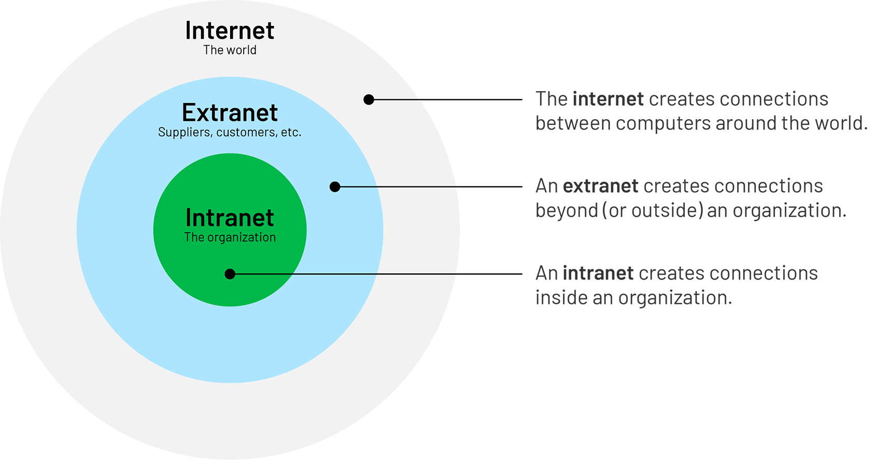

Slide 48
Cont …
There are three different levels of networked systems: intranets, internets, and the Internet.
Intranets are small local networks connecting computers which are within one organization and which are controlled by a common system administrator.
Internets, on the other hand, connect several networks, and are distinguished in the literature by a lower case i (i.e., “internet” as opposed to “Internet”). These networks are usually located in a small geographic area, and share a common protocol (usually TCP/IP).
The Internet, on the other hand, is the largest network in the world, an international connection of all types and sizes of computer systems and networks. It is a system of small networks of computers linked with other networks via routers and software protocols.
This TCP/IP based network links tens of millions of users, across more than 45,000 networks, in countries spanning the globe. The Internet has become the backbone for global communications and transnational capitalism. •
During the Internet’s infancy, users could connect only via standardized modems and telephone lines.

Slide 49
Cont …
Early service providers, like AOL, initially charged users for the period of time they spent on the Internet. As connection speeds via modems were notoriously slow, individuals racked up substantial charges. This expense was compounded by users who connected via long-distance numbers.
As a result, telephone companies became victimized by criminals (i.e., phreakers) seeking to avoid such charges. As competition increased with the birth of the “Baby Bells,” cost to consumers began to decline.
Connections made via modem are known as dial-up connections. • Such connections were originally categorized by the transfer rate of data using an older measure of bandwidth known as baud.
Initially, a transfer rate of 300 baud was common.
Such rates quickly evolved as market demand increased, and 1,200, 2,400, 4,800, and 9,600 baud became the standard.
As these modem bandwidth rates grew, a new designation of transfer speed was developed. Currently, data transfer rates are categorized as kilobits per second (Kbps) or megabits per second (Mbps).

Slide 50
Thank you

